Slide 1
Prediction of Movie Ratings using Artificial Neural Networks
Luddy School of Informatics
INDIANA UNIVERSITY BLOOMINGTON

Slide 2
Presentation overview
AGENDA
Objective
Plan of Approach.
Data Cleaning and Preprocessing
Exploratory Data Analysis
Results

Slide 3
Objective
SECTION 1

Slide 4
Objective
OBJECTIVE
From the taken ‘Movies’ dataset, the major objective to predict the rating of a movie given a certain set of parameters such as genre, names of the cast members etc. To achieve this goal, a number of data cleaning techniques have been used to filter the useful data and feed it the model to obtain the ratings.
Dataset used: https://github.com/chandinisaikumardukka/movie_rating_prediction

Slide 5
Plan of Approach
SECTION 2

Slide 6
PLAN OF APPROACH
Data Cleaning and Preprocessing
Exploratory Data Analysis
Feature Engineering
Data Scaling
Modelling
Evaluation

Slide 7
Data Cleaning and Preprocessing
DATA CLEANING AND PREPROCESSING
Replacing the null values with mean and mode
Generalizing the genre attributes
Dropped the primary_name feature
Categorized the movies based on the number of votes
Generalized the primary_profession feature
Dropped movie name and primary profession after one-hot encoding

Slide 8
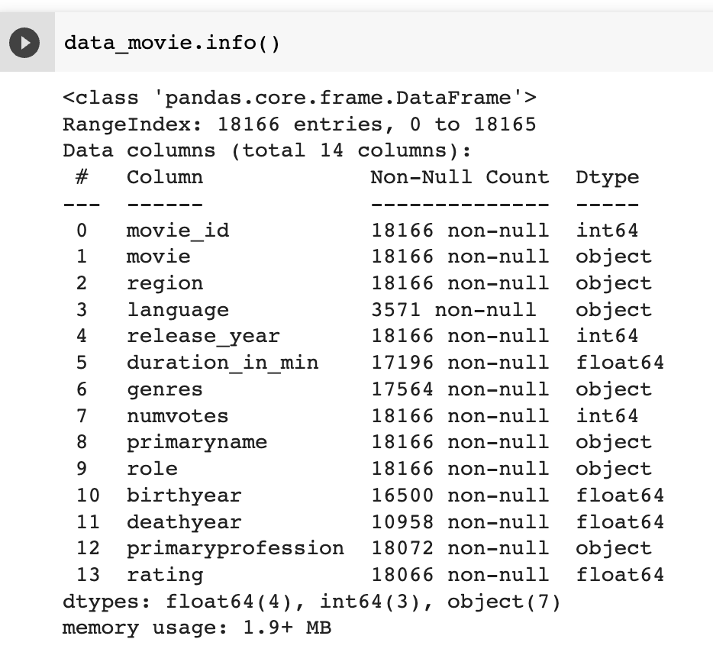
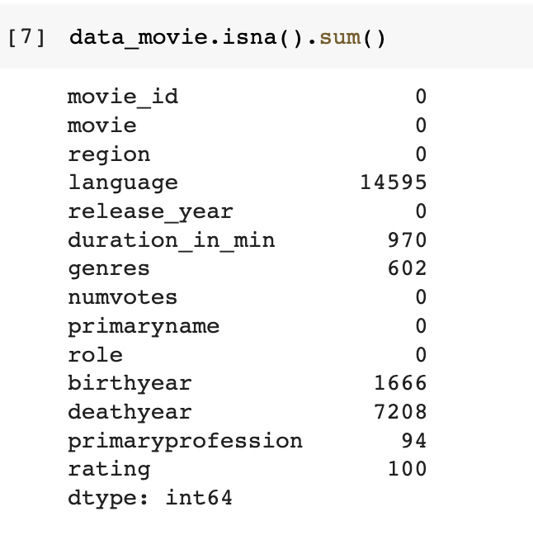
PLAN OF APROACH
The null values in other features such as duration_in_min, birthyear, deathyear are replaced with the mean value of their respective column while null values in genres and primary profession are replaced with the mode of the values.
Considering the size of the dataset, language has the most null values, hence it is dropped
Features in the dataset

Slide 9
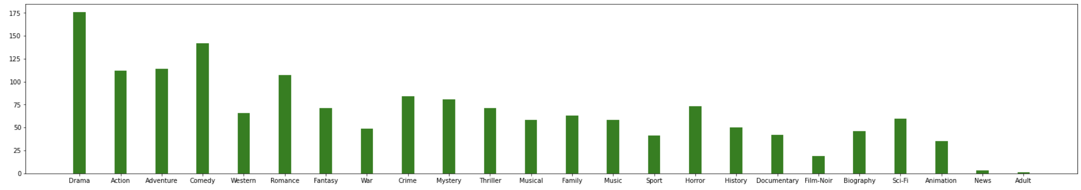
PLAN OF APROACH
Bar graph to visualize the frequencies of various genres
From the above bar chart, We can infer that the genre with the max frequency is ‘drama, Comedy and Adventure’ Also since the number of genres are high, a few subgenres with minimum frequencies such as musical, western, war are clubbed into a main genre with a high frequency.

Slide 10
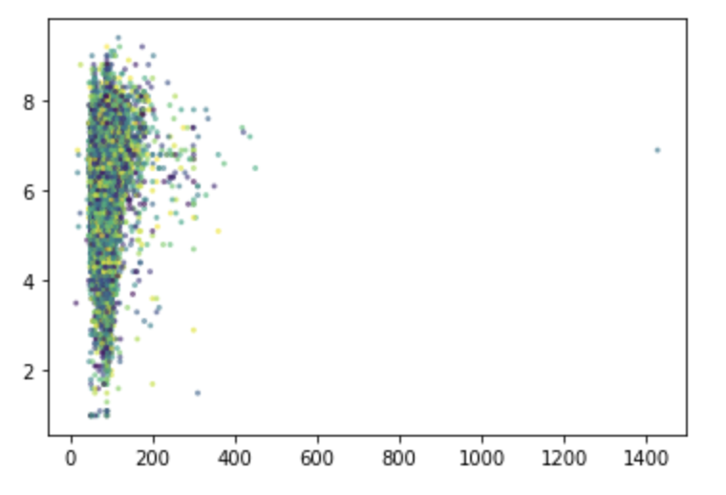
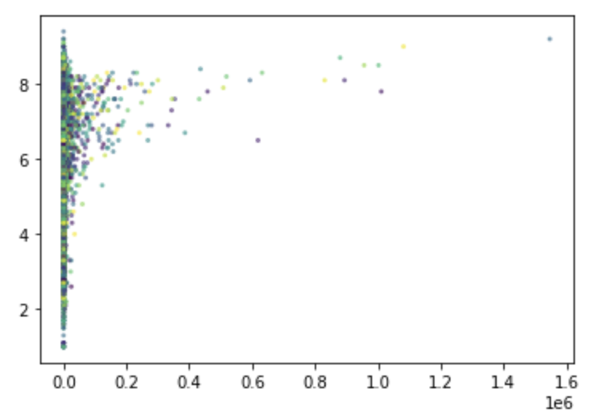
Exploratory Data Analysis.
PLAN OF APPROACH
Outlier removal for ratings in the x-axis and duration on the y-axis
Outlier removal for ratings in the x-axis and number of votes on the y-axis

Slide 11
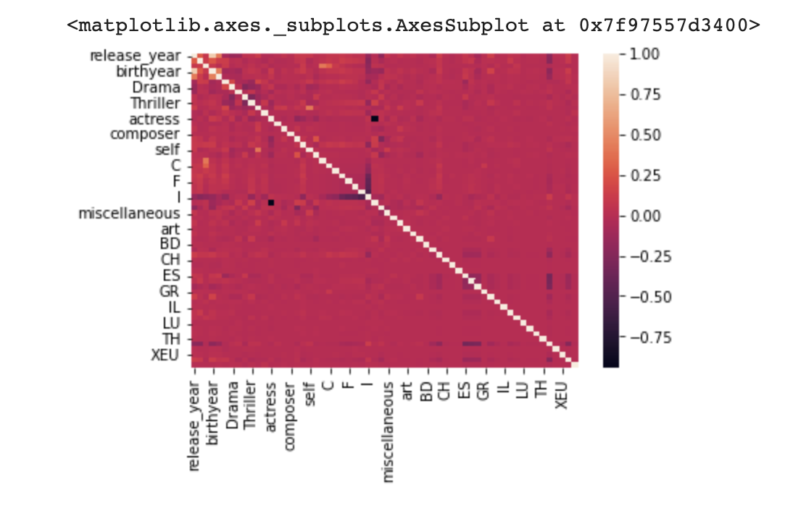
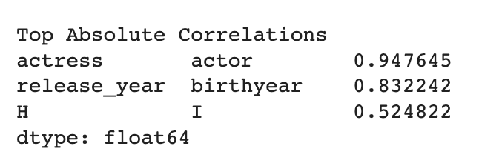
Feature Engineering
PLAN OF APPROACH
Since we’ve considered the correlation threshold to be 90%, We’ve dropped the actor attribute

Slide 12
Machine Learning Model
MODELS
Gradient Boosting Regression
Support Vector Regression
Linear Regression
Stochastic Gradient Descent Regressor
Ridge Regressor
Lasso Regressor
Random Forest Regressor
Adaboost Regressor

Slide 13
Proposed ANN Architecture
MODELS
ANN + Dense layers.
ANN + Dropout +Dense layers.

Slide 14
Results
SECTION 3

Slide 15
Results
RESULTS
Model | R2 Score | Mean Squared Error
Gradient Boosting Regressor | 0.26 | 0.013
Support Vector Regressor | 0.20 | 0.01
Linear Regressor | -4.87 | 8.70
Stochastic Gradient Descent Regressor | 0.14 | 0.01
Ridge Regressor | 0.18 | 0.01
Lasso Regressor | 0.003 | 0.017
Random Forest Regressor | 0.26 | 0.01
Adaboost Regressor | 0.05 | 0.01
Model | R2 Score | Mean Squared Error
ANN+ Dense Layers | 0.90 | 0.0016
ANN+ Dropout(0.5)+ Dense Layers | 0.82 | 0.0030
ANN+ Dropout(0.2)+ Dense Layers | 0.86 | 0.0023

Slide 16
Thank you

